Slide 1
E-retail factors for customer activation and rention: A case study from Indian e-commerce customers
Customer satisfaction has emerged as one of the most important factors that guarantee the success of online store; it has been posited as a key stimulant of purchase, repurchase intentions and customer loyalty. A comprehensive review of the literature, theories and models have been carried out to propose the models for customer activation and customer retention. Five major factors that contributed to the success of an e-commerce store have been identified as: service quality, system quality, information quality, trust and net benefit. The research furthermore investigated the factors that influence the online customers repeat purchase intention. The combination of both utilitarian value and hedonistic values are needed to affect the repeat purchase intention (loyalty) positively. The data is collected from the Indian online shoppers. Results indicate the e-retail success factors, which are very much critical for customer satisfaction.

Slide 2
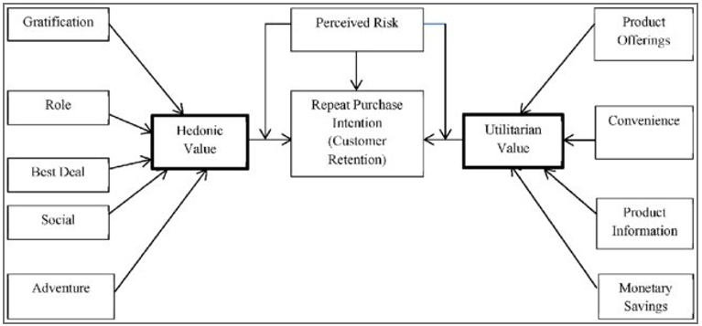

Slide 3
Problem Statement-
Customer retention
The customer retention is the process of engaging existing customers to continue buying products or services from the business.
Customer satisfaction
Customer satisfaction is a measurement that determines how happy customers are with a company’s products, services, and capabilities. Customer satisfaction information, including surveys and ratings, can help a company determine how to best improve or changes its products and services.
E-retail success.
How many happy customers does the particular e-retail website have.
Data Analysis.
Need to perform analysis on the data that has been provided and according to EDA, Visualization and other analysis, need to conclude the findings from analysis.

Slide 4
Understanding:
There are 2 excel sheets in the dataset that has been shared.
First, excel sheet is the detailed data of the e-retail website.
Second, excel sheet is the encoded data of the e-retail websites.
There are information of customers who do shopping online from different websites.
The information can be good as well as bad feedback for e-retail websites.
There are so many questions, polls and feedback columns in our dataset.
There are feedbacks & customer reviews of e-retail website such as:
Amazon.in
Flipkart.com
Myntra.com
Paytm.com and more.

Slide 5
EDA:
Shape of first dataset is 269, 71.
Shape of second dataset is also 269, 71.
Information of df1 datasheet.
RangeIndex: 0 to 268
Data columns: 71
dtypes: int64(1), object(70)
Information of df2 Datasheet.
dtypes: int64(46), object(25).

Slide 6
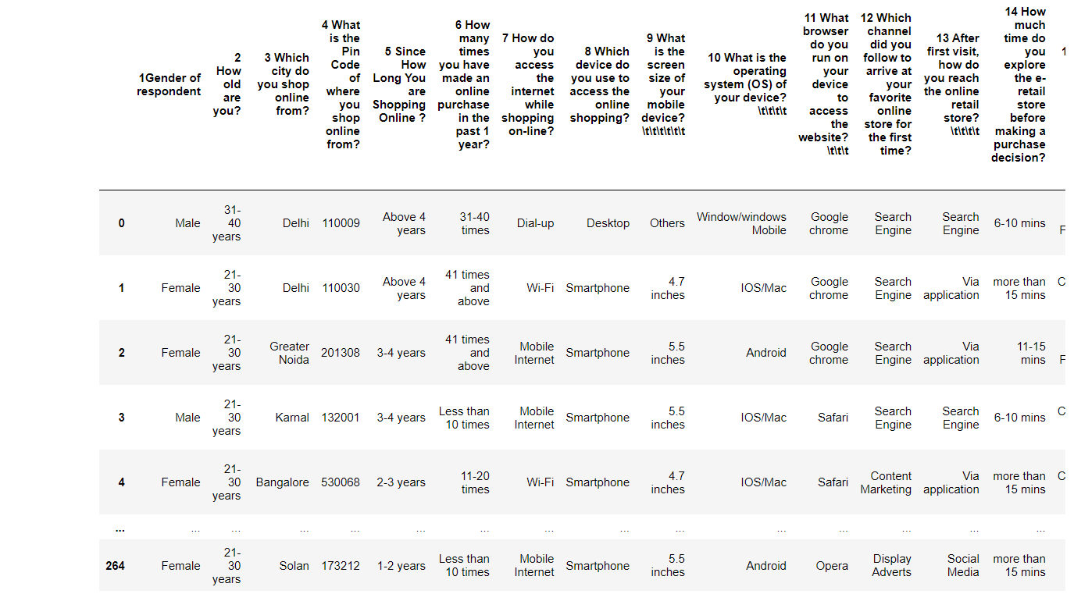
First Dataset

Slide 7
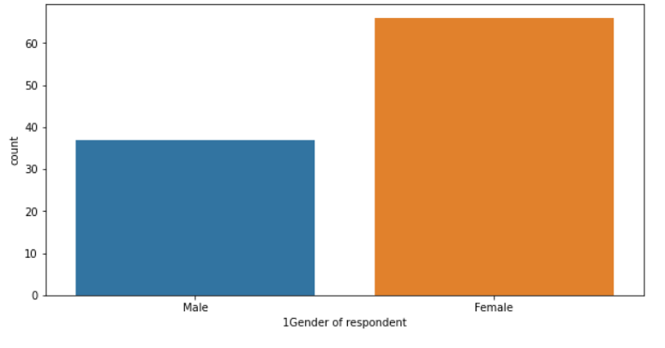
Visualisation
Female customers are more than male customers

Slide 8
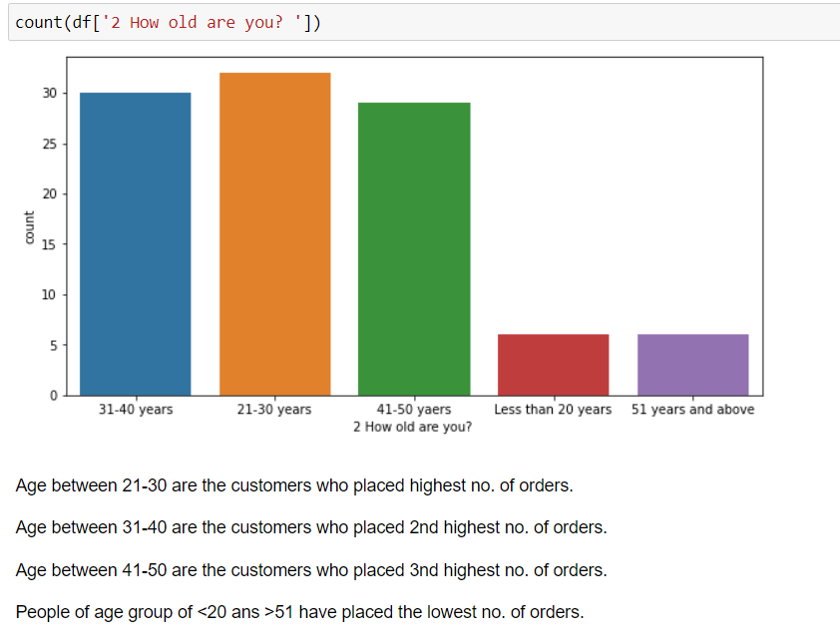

Slide 9
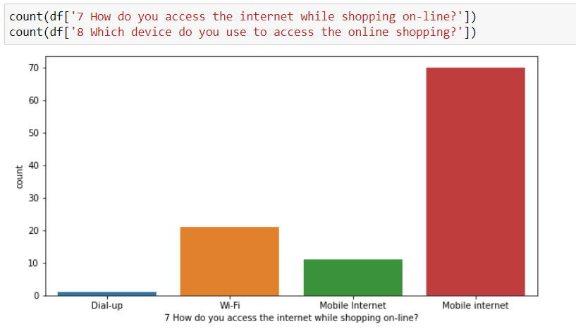
How do you access the internet while shopping on-line?.
1.Mobile Internet.
2.Wi-fi
3.Dial-up

Slide 10
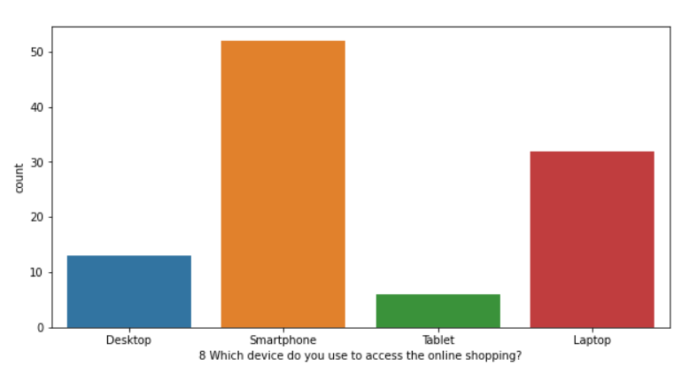
Which device do you use to access the online shopping?
1.Smartphones.
2.Laptop.
3.Desktop.
4.Tablet.

Slide 11
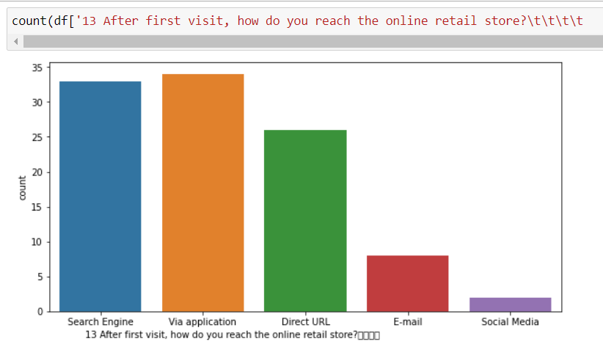
After first visit, how do you reach the online retail store?
1.Via Application.
2.Search Engine.
3.Direct URL.
4.E-mail.
5.Socail Media.

Slide 12
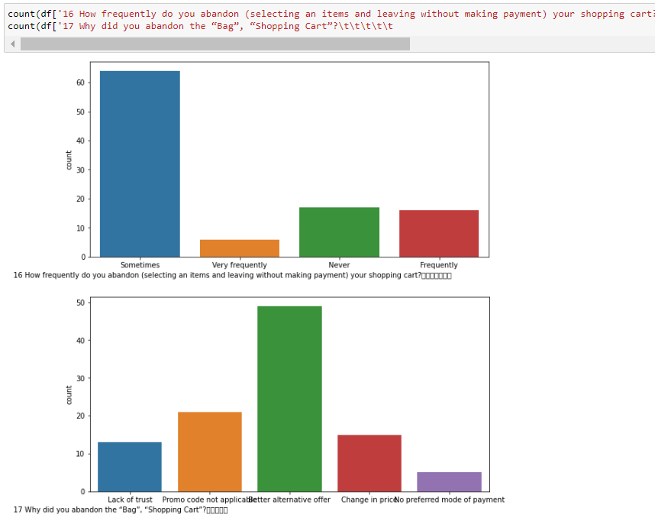
How frequently do you abandon (selecting an items and leaving without making payment) your shopping cart?
1.There are more number of customer, who abandon the shopping cart, Sometimes.
2.Never.
3.Frequently.
4.Very less number of customer abandon the shopping cart, very frequently.

Slide 13
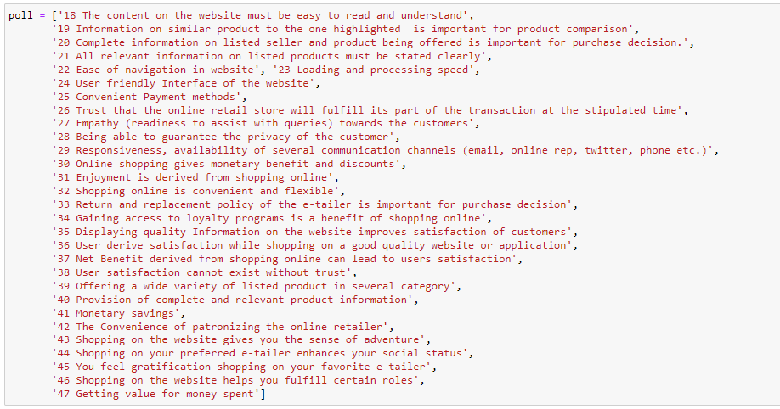
Polls

Slide 14
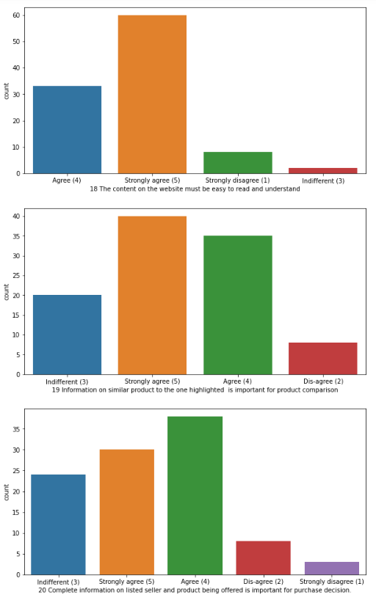
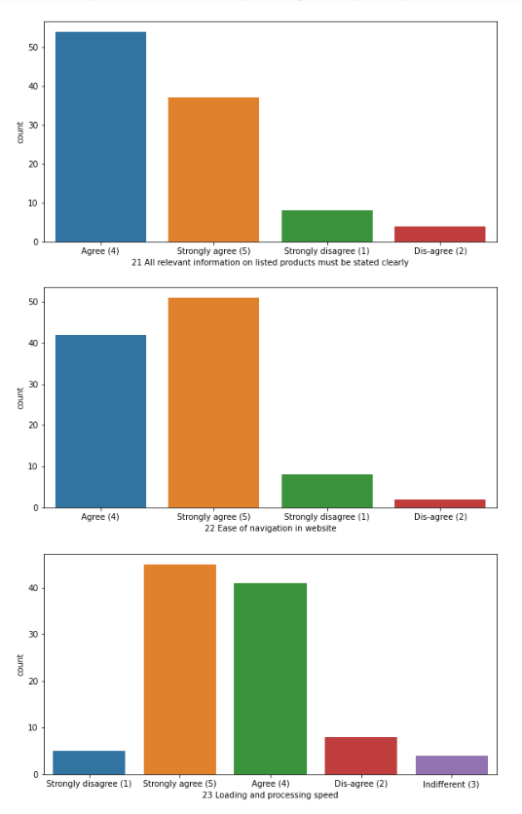
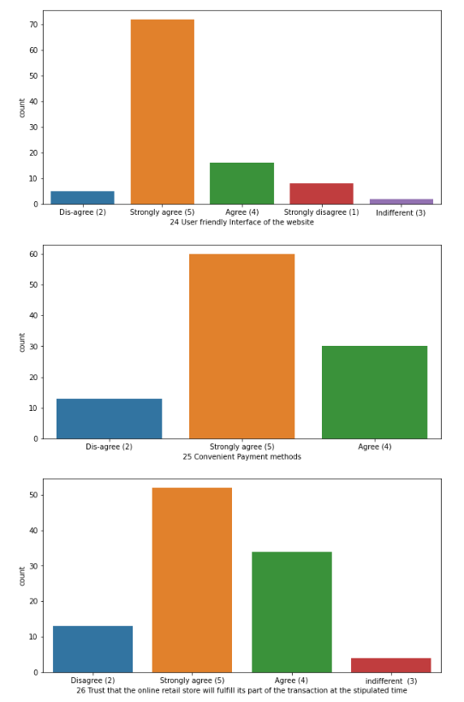

Slide 15
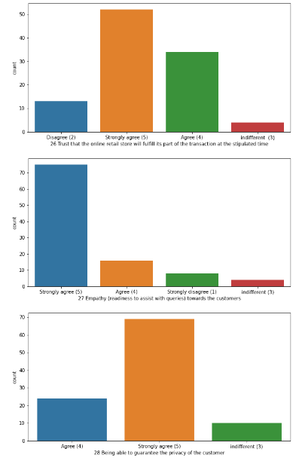
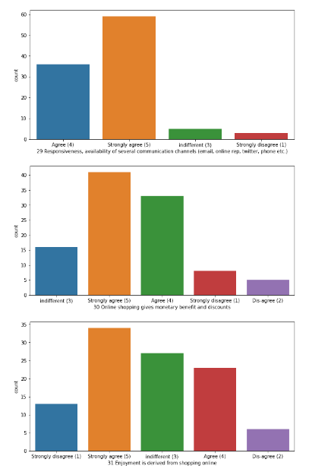
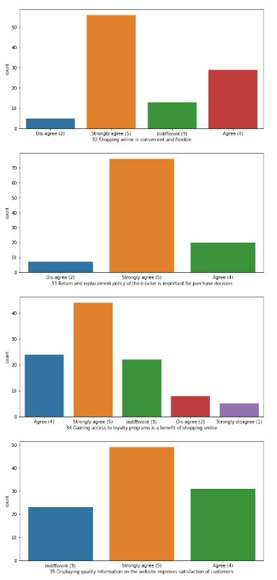
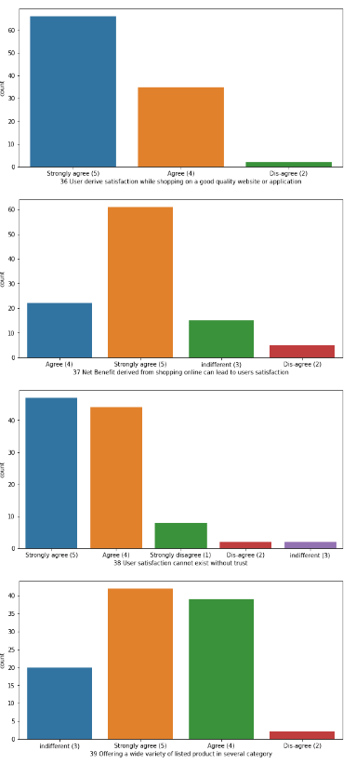

Slide 16
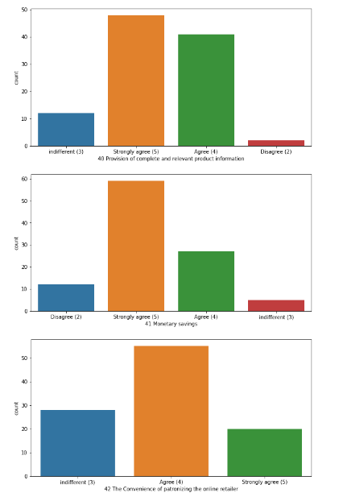
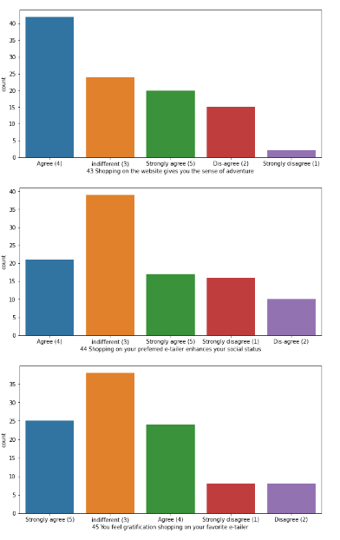
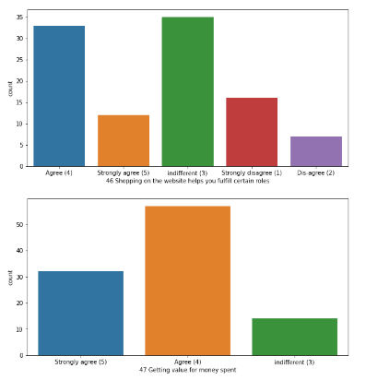

Slide 17
Strongly agree/Agree/Disagree/Strongly disagree/Indifferent Poll.
Strongly agree/Agree, can be considered as Agreed.
Disagree/Strongly disagree, can be considered as Disagree.
* All the columns in sd are like the poll columns for the customers, where they have to agree or disagree with the question of poll with there own experience on website they shop at ... *
Most of the customers are agreed with the question and giving there opinions on the website.
There are very less number of customers who have voted for disagreed the condtition or question.
In some of the columns the preference have been given to the Indifferent, like:
Shopping on your preferred e-tailer enhances your social status.
You feel gratification shopping on your favorite e-tailer.
Shopping on the website helps you fulfill certain roles.

Slide 18
Positive Feedback
From the following, tick any (or all) of the online retailers you have shopped from Easy to use website or application Visual appealing web-page layout', 'Wild variety of product on offer Complete, relevant description information of products
Fast loading website speed of website and application Reliability of the website or application
Quickness to complete purchase Availability of several payment options
Speedy order delivery Privacy of customers’ information Security of customer financial information Perceived Trustworthiness
Presence of online assistance through multi-channel

Slide 19
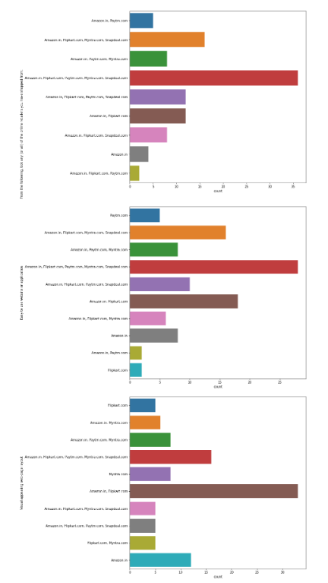
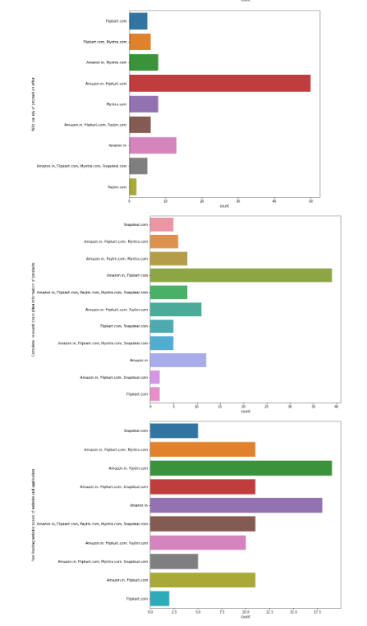
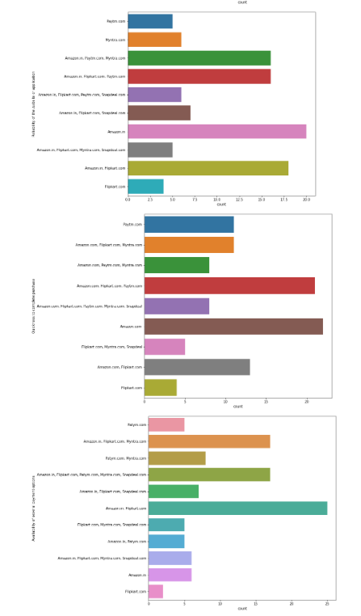

Slide 20
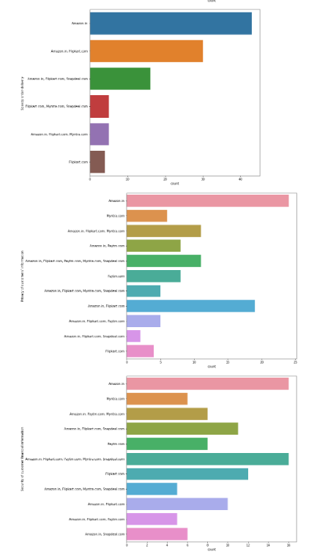
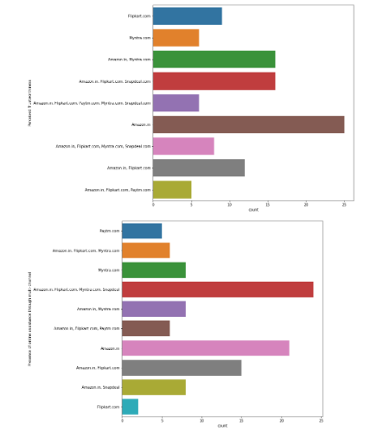

Slide 21
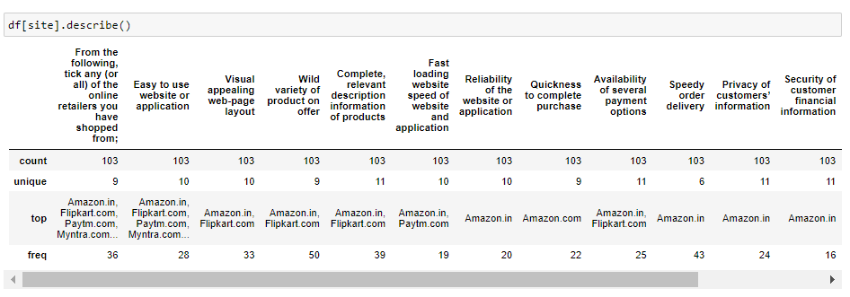
Based on customers experenice, they have voted for the website and these questions are the positive feedback for every website.
Amazon.in
Flipkart.com
Myntra.com are on the top in vote for every questions asked to the customers. So, we can considered that these websites are the shopping website, which is loved by custmores, and having alot of happy customers with it.

Slide 22
Negative Feedback
Longer time to get logged in (promotion, sales period) Longer time in displaying graphics and photos (promotion, sales period) Late declaration of price (promotion, sales period) Longer page loading time (promotion, sales period) Limited mode of payment on most products (promotion, sales period) Longer delivery period', 'Change in website/Application design
Frequent disruption when moving from one page to another

Slide 23
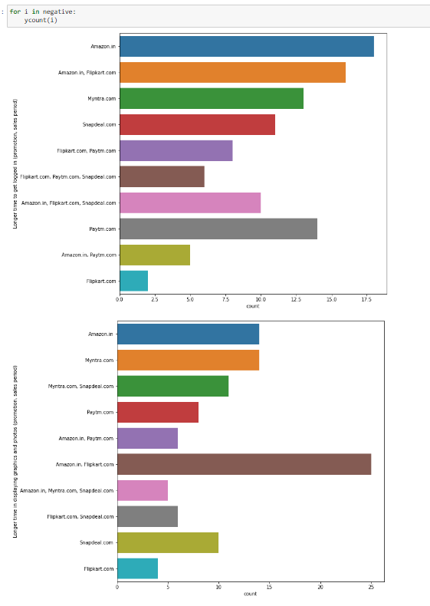
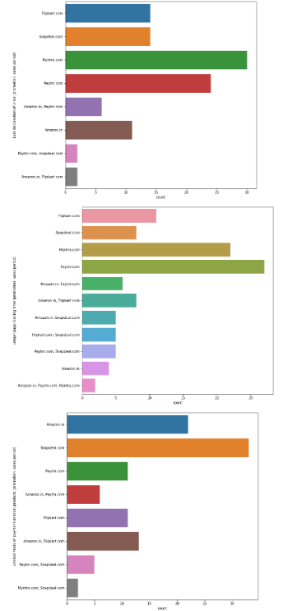
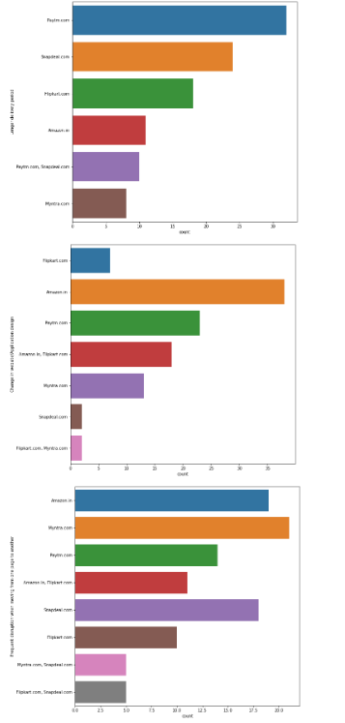

Slide 24
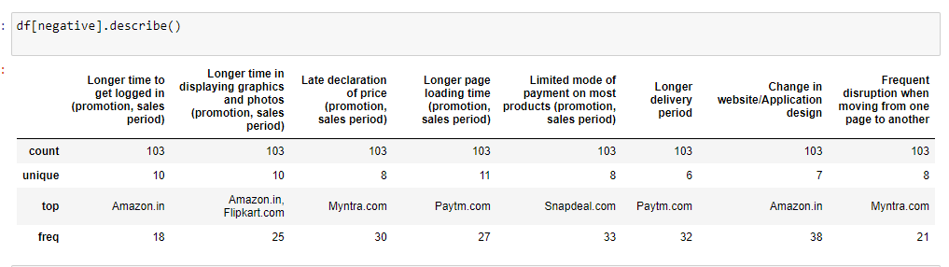

Slide 25
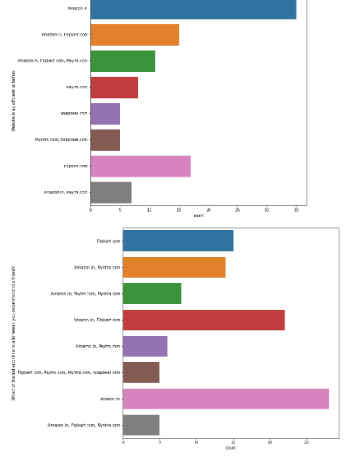
Website is as efficient as before Positive for Website, 1.Amazon is still on the top and after that flipkart is there. 2.Which of the Indian online retailer would you recommend to a friend? 3.Amazon.in is the most recommended website, among all other website. 4.Myntra.com & Flipkart.com, are on the 2nd in recommendation

Slide 26
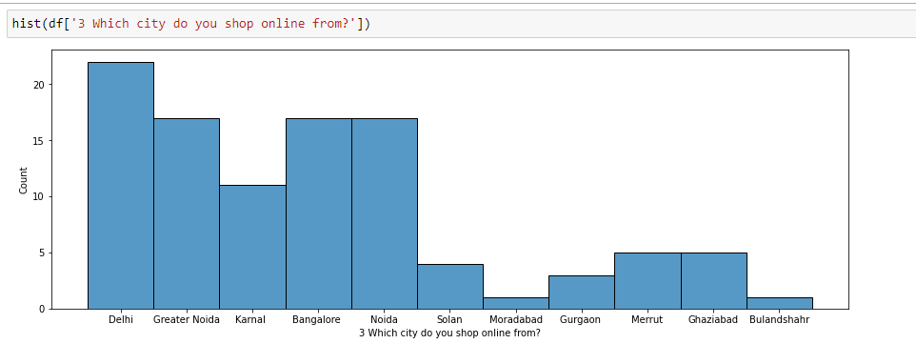
Which city do you shop online from?
Top to Down.
1.Delhi
2.Greater Noida.
3.Noida.
4.Bangalore.
5.Karnal.
6.Solan & Ghaziabad.
7.Gurgaon.
8.Merut.
9.Moradabad.
10.Bulandshahr.

Slide 27
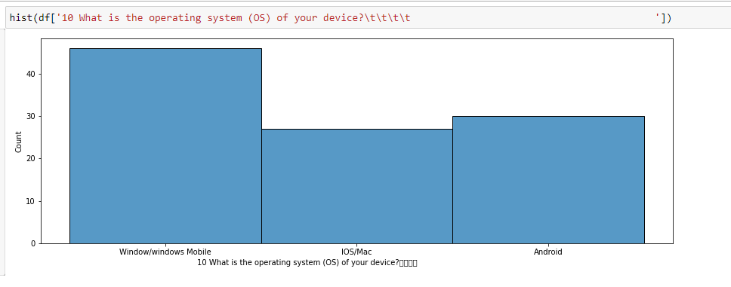
What is the operating system (OS) of your device?
1.Windows
2.Android.
3.IOS/Mac.

Slide 28
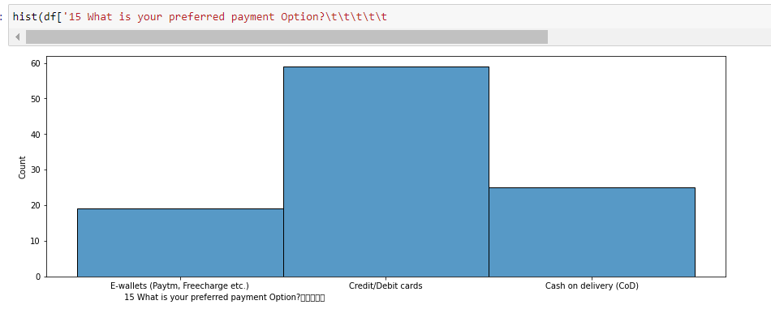
What is your preferred payment Option?
1.Most of the customers, prefer the Credit/Debit cards option to make the payment on website for online shopping.
2.Cash on delivery(COD), comes next in preference of payment method.
3.E-wallets like paytm,freecharge etc, comes last on the preference.

Slide 29
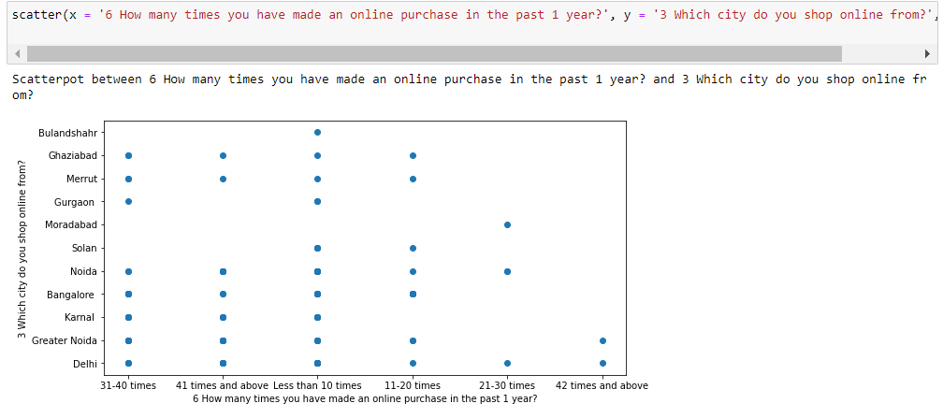

Slide 30
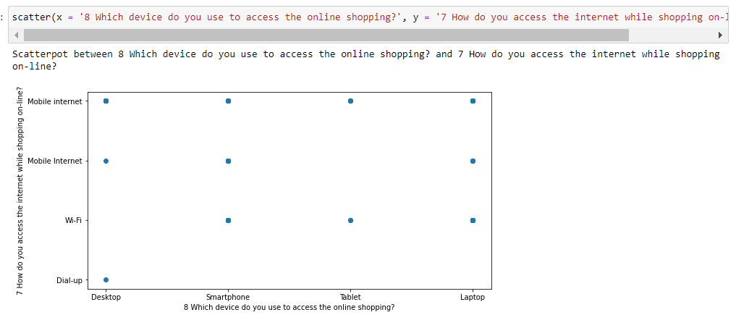

Slide 31
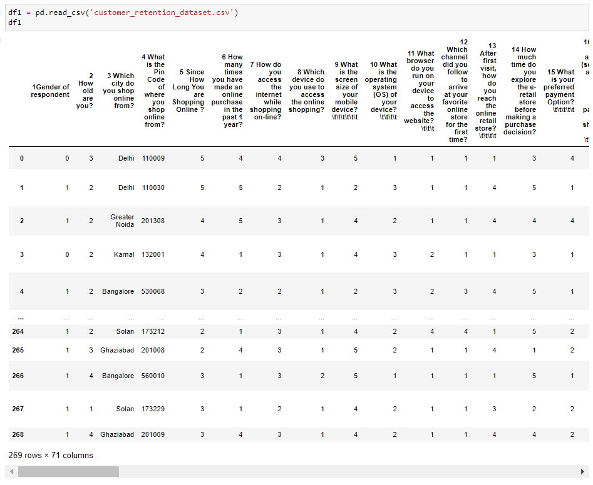
Second Dataset

Slide 32
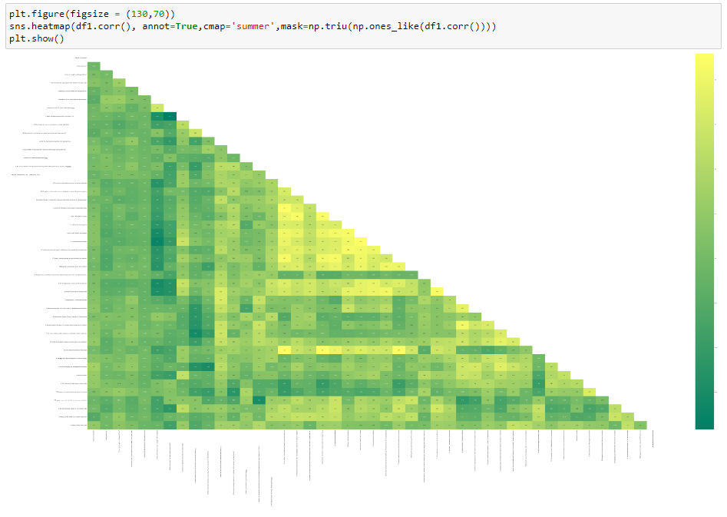
Correlation

